Slide 1
Part 4 Network Layer
Chapter 19 Logical Addressing
Chapter 20 Internet Protocol
Chapter 21 Address Mapping, Error Reporting, and Multicasting
Chapter 22 Delivery, Forwarding, and Routing

Slide 2
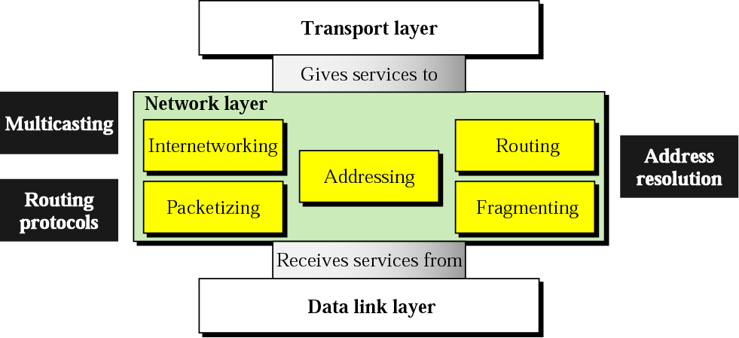
Position of network layer
The network layer is responsible for the delivery of individual packets from the source to the destination host

Slide 3
Chapter 19. Network Layer: Logical Addressing
19.1 IPv4 Addresses
19.2 IPv6 Addresses

Slide 4
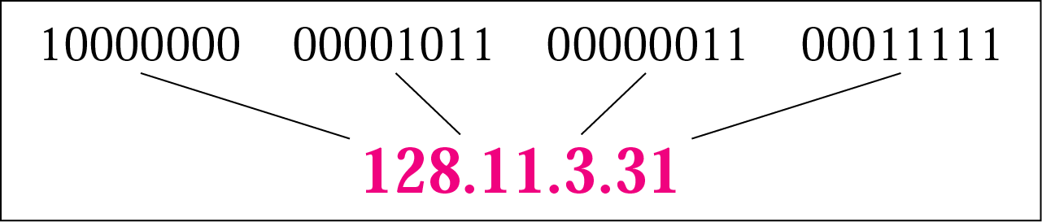
IPv4 Addresses
An IP address is a 32-bits long
The IP addresses are unique and universal
The address space of IPv4 is 2³² or 4,294,967,296
Binary notation: 01110101 10010101 00011101 00000010
Dotted-decimal notation: 117.149.29.2

Slide 5
Example
Change the following IP addresses from binary notation to dotted-decimal notation.
a. 10000001 00001011 00001011 11101111
b. 11111001 10011011 11111011 00001111
We replace each group of 8 bits with its equivalent decimal number and add dots for separation:
a. 129.11.11.239
b. 249.155.251.15

Slide 6
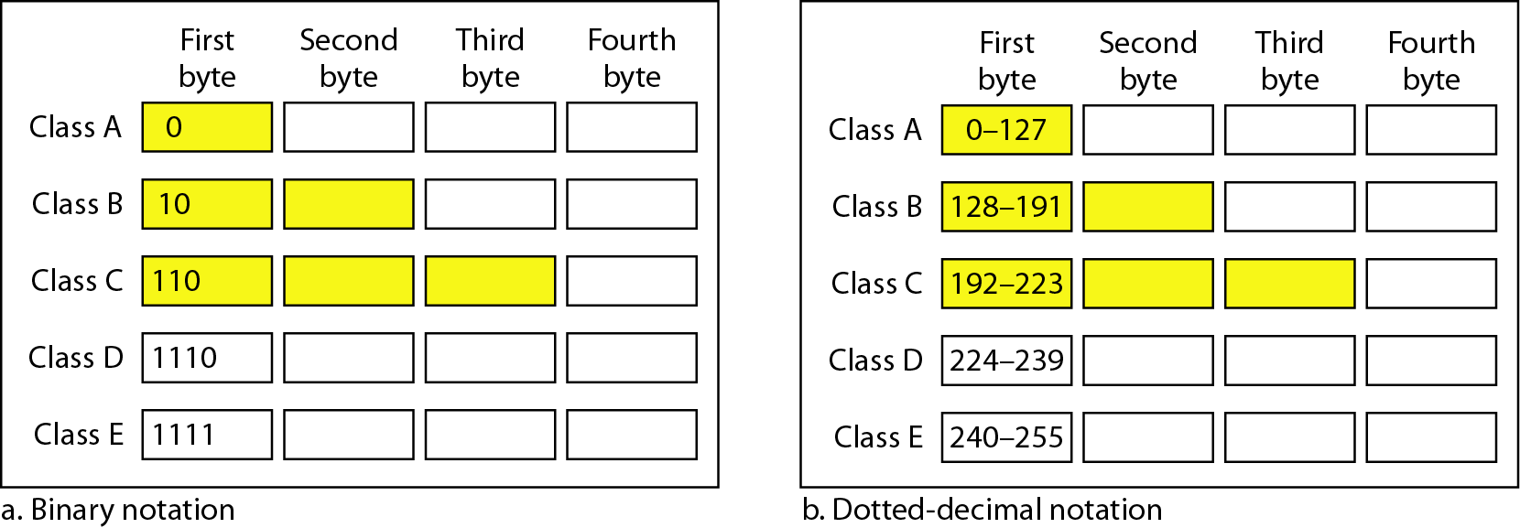
Classful addressing
In classful addressing, the address space is divided into five classes: A, B, C, D, E
A new architecture, called classless addressing was introduced in the mid-1990s

Slide 7
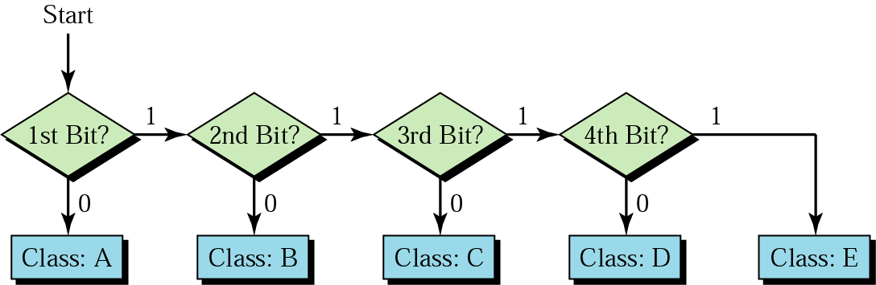
Finding the address class

Slide 8
Classful Addressing: Example
Find the class of each address.
a. 00000001 00001011 00001011 11101111
b. 11000001 10000011 00011011 11111111
c. 14.23.120.8
d. 252.5.15.111
Solution
a. The first bit is 0. This is a class A address.
b. The first 2 bits are 1; the third bit is 0. This is a class C address.
c. The first byte is 14; the class is A.
d. The first byte is 252; the class is E.

Slide 9
Classes and Blocks
In classful addressing, a large part of the available addresses were wasted

Slide 10
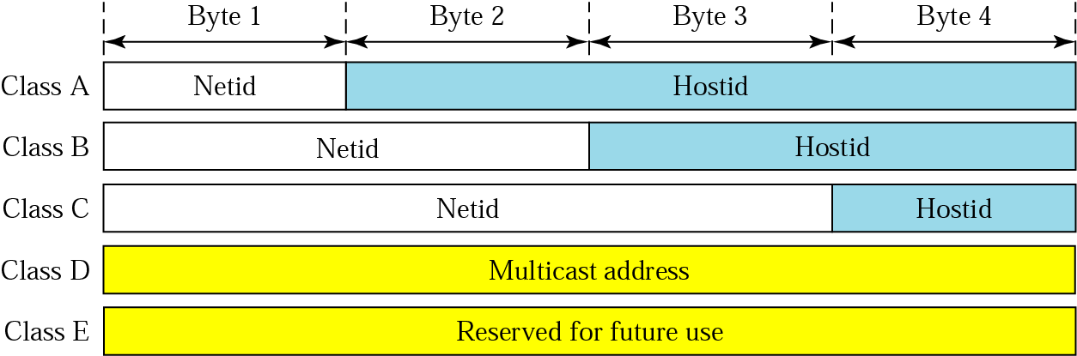
Netid and Hostid
IP address in classes A, B, and C is divided into netid and hostid

Slide 11
Mask: Default Mask
The length of the netid and hostid is predetermined in classful addressing
Default masking
CIDR (Classless Interdomain Routing) notation

Slide 12
Subnetting
Divide a large block of addresses into several contiguous groups and assign each group to smaller networks called subnets
Increase the number of 1s in the mask
Supernetting
Combine several class C blocks to create a larger range of addresses
Decrease the number of 1s in the mask (/24 → /22 for C addresses)

Slide 13
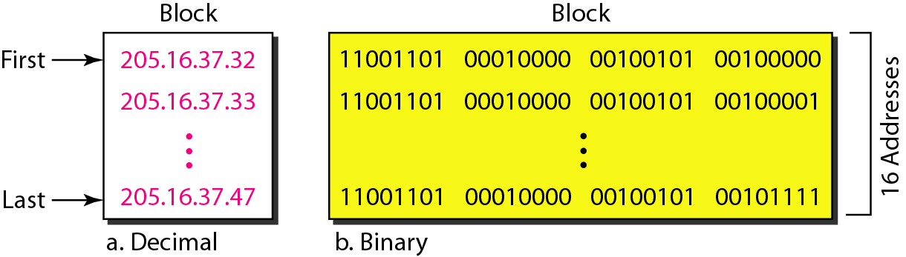
Classless addressing
Classful addressing has created many problems
Many ISPs and service users need more addresses
Idea is to have variable-length blocks that belong to no class
Three restrictions on classless address blocks;
The addresses in a block must be contiguous, one after another
The number of addresses in a block must be a power of 2
The first address must be evenly divisible by the number of addresses

Slide 14
Mask and Address Blocks
In IPv4 addressing, a block of addresses can be defined as x.y.z.t /n in which x.y.z.t defines one of the addresses and the /n defines the mask.
The first address in the block can be found by setting the rightmost 32 − n bits to 0s
The last address in the block can be found by setting the rightmost 32 − n bits to 1s
The number of addresses in the block can be found by using the formula 2^{32−n}
Example: 205.16.37.39/28
The binary representation is 1100110 00010000 00100101 00100111
If we set 32 − 28 rightmost bits to 0, we get 11001101 00010000 00100101 00100000
→ 205.16.37.32 (First address)
If we set 32 − 28 rightmost bits to 1, we get 11001101 00010000 00100101 00101111
→ 205.16.37.47 (Last address)
The value of n is 28, which means that number of addresses is 2³²⁻²⁸ or 16

Slide 15
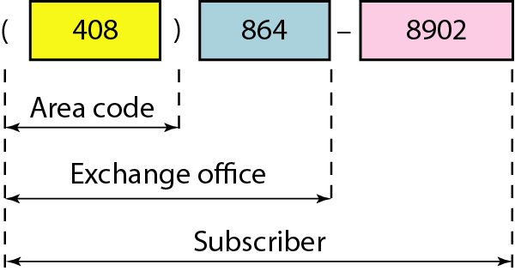
Network Address
The first address in a block is normally not assigned to any device; it is used as the network address that represents the organization to the rest of the world
Hierarchy

Slide 16
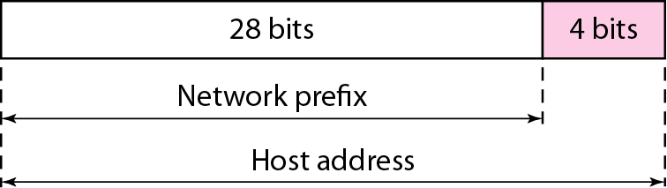
Two-Level Hierarchy: No Subnetting
Each address in the block can be considered as a two-level hierarchical structure: the leftmost n bits (prefix) define the network; the rightmost 32 − n bits define the host

Slide 17
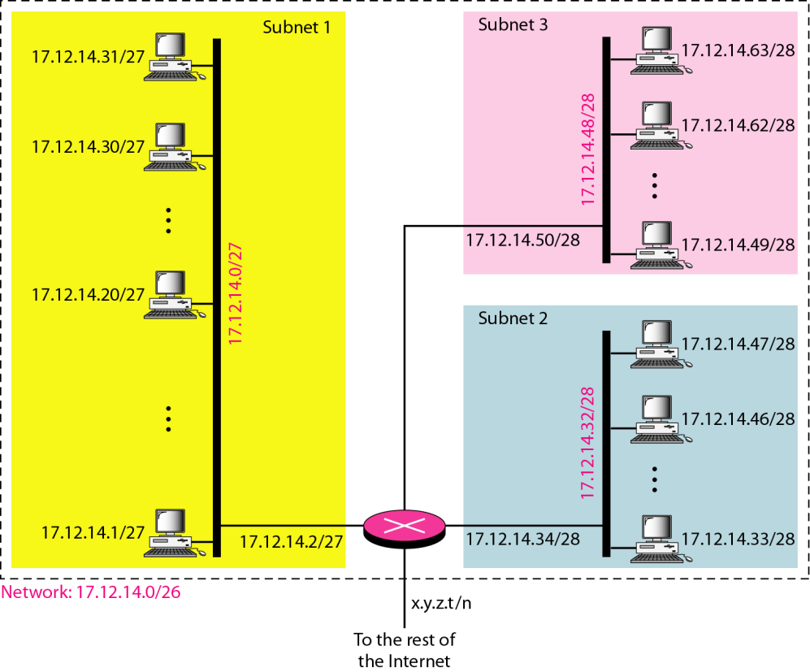
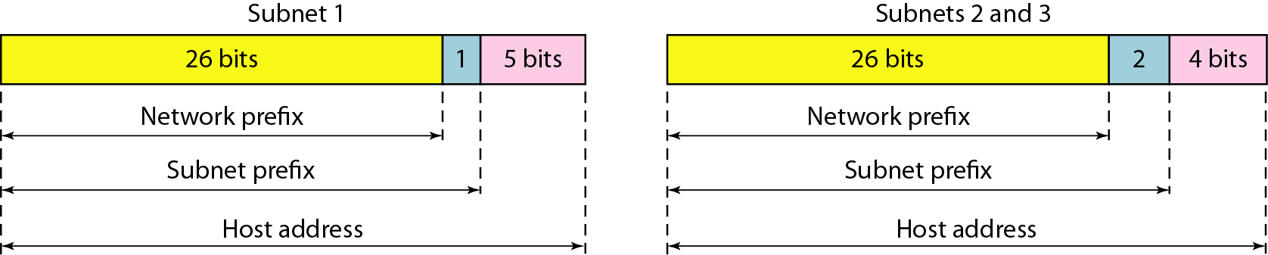
Three-Levels of Hierarchy: Subnetting

Slide 18
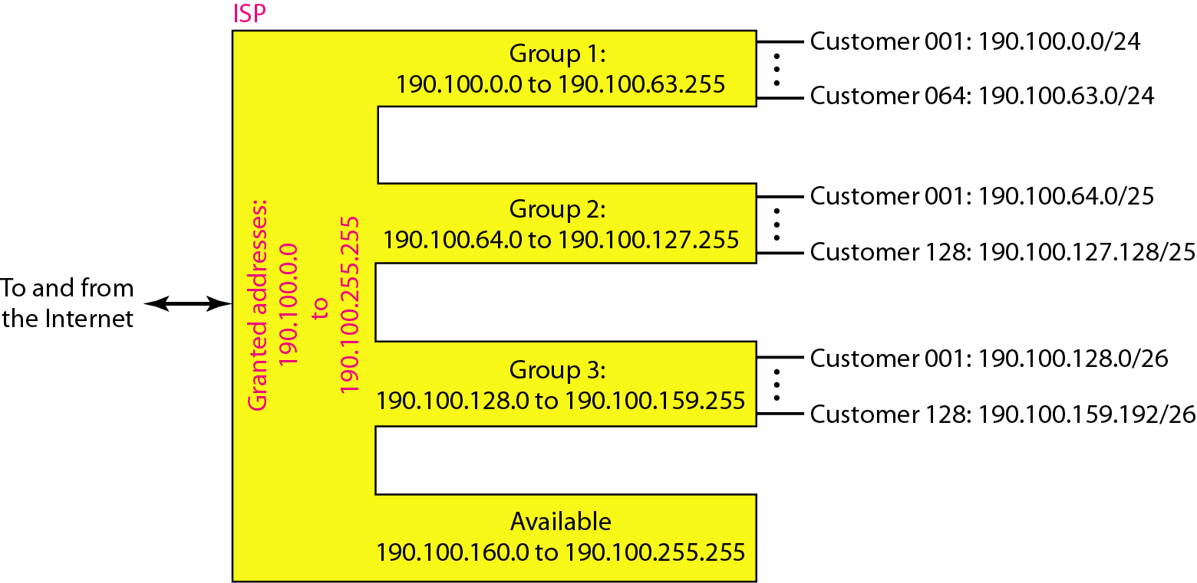
Address Allocation and Distribution: Example
The first group has 64 customers; each needs 256 addresses.
The second group has 128 customers; each needs 128 addresses.
The third group has 128 customers; each needs 64 addresses.

Slide 19
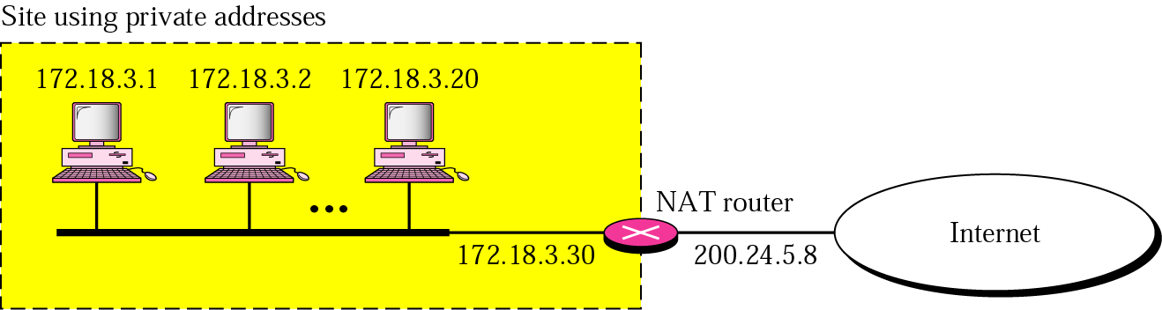
Network Address Translation: NAT
NAT enables a user to have a large set of addresses internally and one address, or a small set of addresses, externally.
Range | Total
10.0.0.0 to 10.255.255.255 | 2²⁴
172.16.0.0 to 172.31.255.255 | 2²⁰
192.168.0.0 to 192.168.255.255 | 2¹⁶
Addresses for private networks

Slide 20
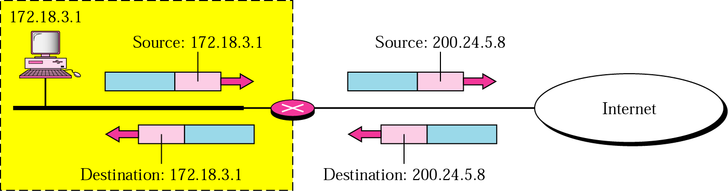
Addresses Translation
Address translation for source address of outgoing packet and for destination address of incoming packet

Slide 21
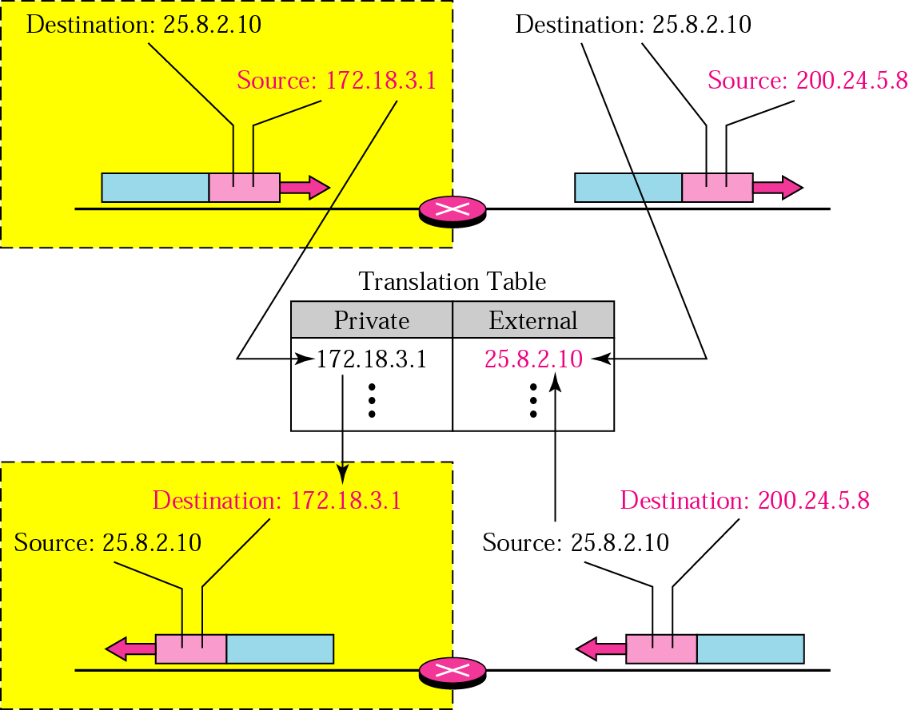
Translation Table
Using (1) one IP address, (2) a pool of IP address, and (3) both IP addresses and port numbers

Slide 22
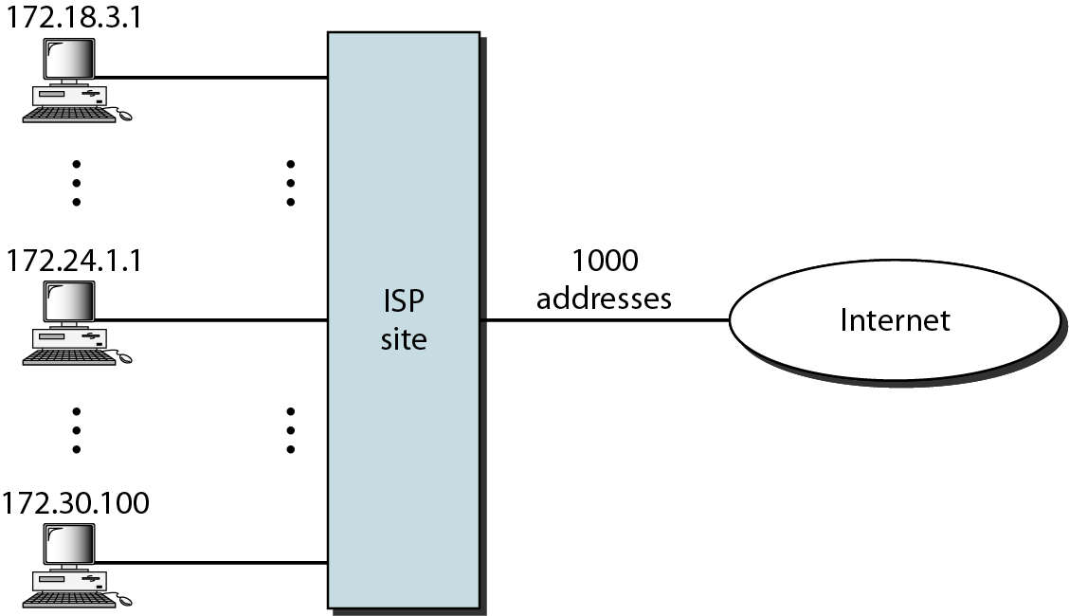
Five-Column Translation Table
ISP and NAT

Slide 23
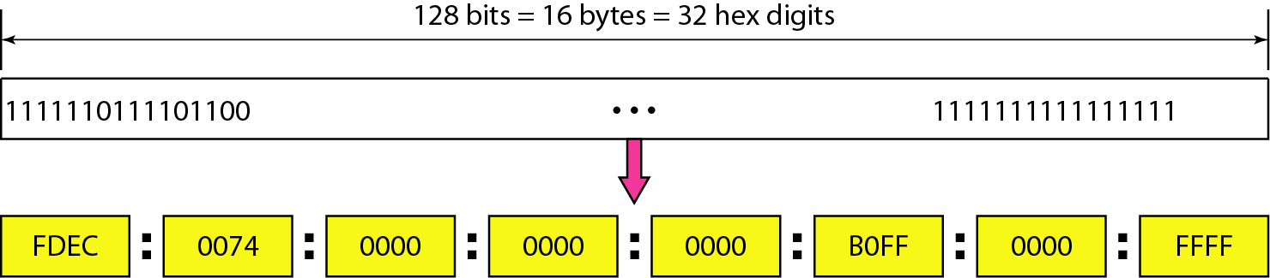
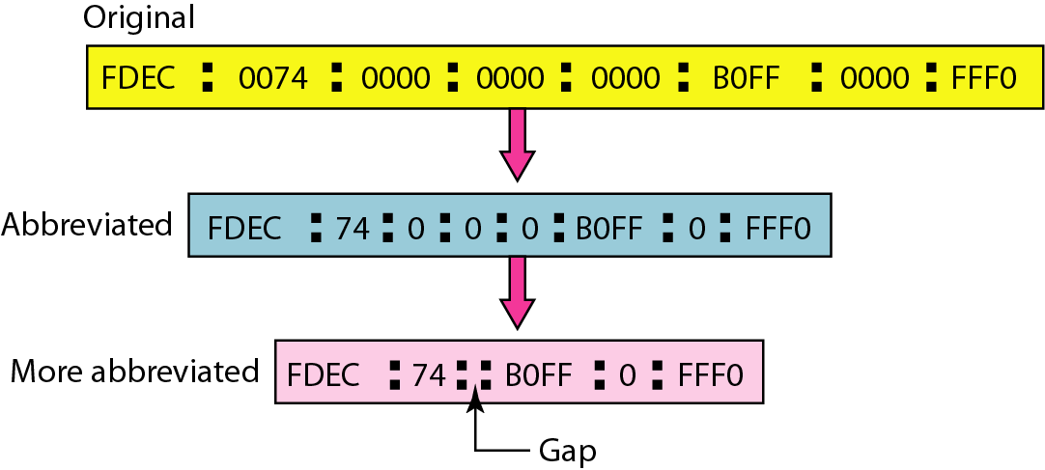
IPv6 Addresses
Despite all short-term solutions, such as classless addressing, DHCP (Dynamic Host Configuration Protocol), and NAT, still address-hungry
An IPv6 address is 128 bits long
Hexadecimal colon notation:
Abbreviation:

Slide 24
IPv6 Address Space

Slide 25
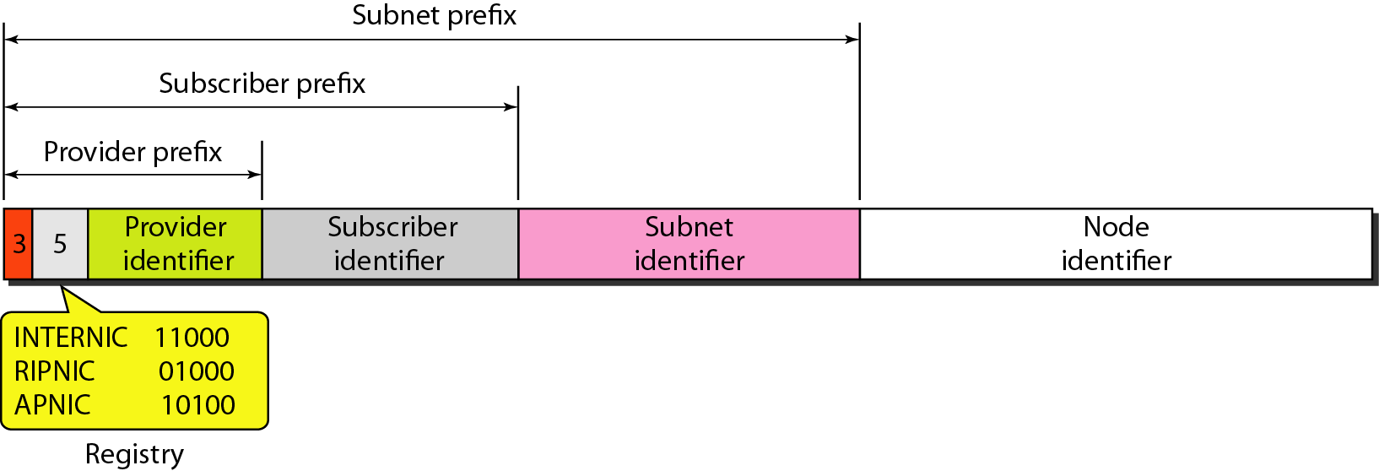
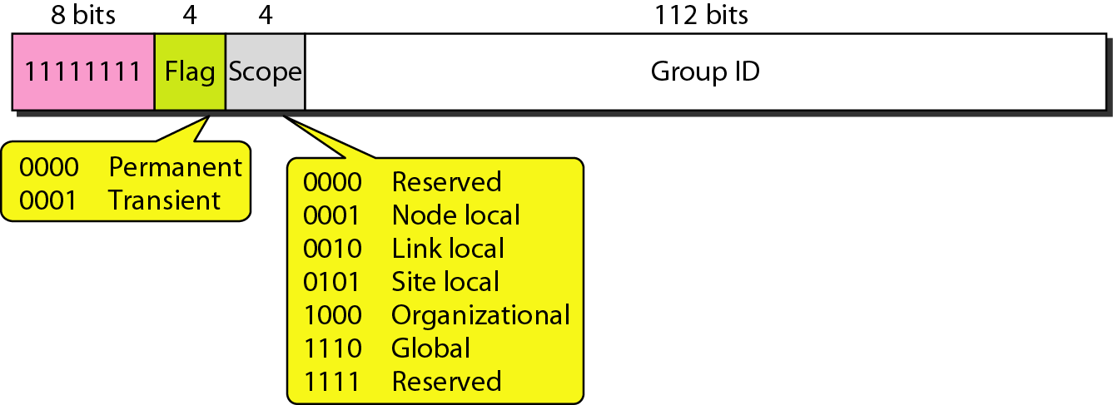
IPv6 Addresses
Unicast addresses: define a single computer
Two types: geographically based and provider-based
Prefixes for provider-based unicast address
Type id (3 bits), Registry id (5 bits)
Multicast addresses:
define a group of hosts

Slide 26
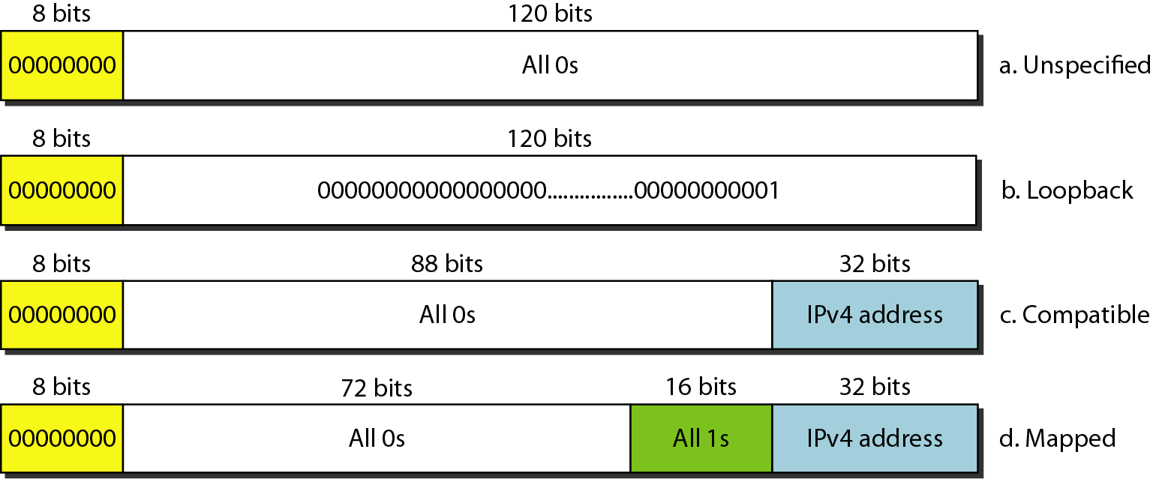
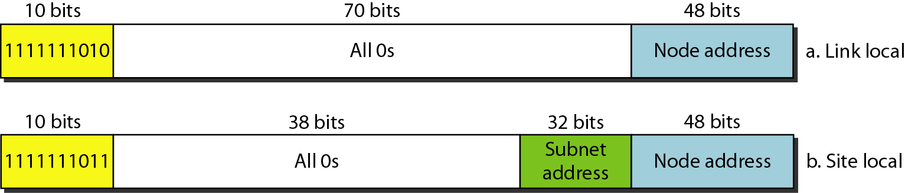
IPv6 Addresses
Anycast addresses: define a group of nodes
Unlike multicast, a packet is delivered to only one of the members of the anycast group, the nearest
Reserved addresses:
Local addresses: private networks

